Slide 1
Final assigment - Capstone project
Examining London’s wards
Lawrence Kiio

Slide 2
Introduction
The project is about finding a proper way to buy a house in London
Using Python and Foursquare api
We have preferences:
least populated area where
the average price is lower then £350.000
it should be safe for sure, and
it would be just nice if the poeple around were not too old

Slide 3
Data collection
Administrative areas
The table (requested from https://www.doogal.co.uk/AdministrativeAreas.php ) conatains the postcode data filtered by administrative area that is Districts. The dataset contain the codes of every districts and their geographical data i.e. Latitude and Longitude
Ward level geographical data
The table requested from http://geoportal.statistics.gov.uk/datasets/wards-december-2018-full-clipped-boundaries-gb/data
To get geographical data about wards. It does not contains ward level data so I could merge it with the London postcodes dataset

Slide 4
Data collection
London postcodes
The table requested from https://www.doogal.co.uk/london_postcodes.php
This is a complete list of London postcode districts with their Ordnance Survey coordinates and longitude and latitude. It seems cool but notice the Latitude and Longitude data are go with the Postcode which is a bit deep level for this examination.
On the other hand, it contains the data of District Code, Ward Code, District, Ward, Rural/urban. Those data would be useful:
District Code and the Ward Code for merging with other datasets,
Rural/urban for the analysis

Slide 5
Data collection
London borough profile
The table requested from https://data.london.gov.uk/dataset/london-borough-profiles
Borough profile displays data for that borough, plus either Inner or Outer London, London and a national comparator (usually England where data is available). The data is set out across 11 themes covering most of the key indicators relating to demographic, economic, social and environmental data.
I would mainly use GLA Population Estimate 2017, GLA Household Estimate 2017, Population density (per hectare) 2017, Average Age, 2017 columns to help me to get closer to the desirable new House.

Slide 6
Data collection
Recorded crime summary
The table requested from https://data.london.gov.uk/dataset/recorded_crime_summary
This data counts the number of crimes at three different geographic levels of London (borough, ward, LSOA) per month, according to crime type. I will not show all the data provided, because I will summarize them i.e. I need only one number per wards to help me compare the safety of wards
House Price Index - HPI
The table requested from https://data.london.gov.uk/dataset/uk-house-price-index
The UK House Price Index (UK HPI) captures changes in the value of residential properties.
The UK HPI uses sales data collected on residential housing transactions, whether for cash or with a mortgage.

Slide 7
Methodology
Using Python and Foursquare API to find a family friendly Ward with regarding venues.
I will limit the analysis to area ~1km around the Ward I found.
In first step I have collected the required data: Location data (Postcodes, Latitude, Longitude), Borough profile, Crime data and House Price Index.
In the second step I am filtering the dataframe so I will find the Ward which attributes are close enough to my expectation.
In the third step I will use clustering technique to find differences among the Wards. I will use those clusters to decide where should I start to explore the neighborhood personally. I will present map of all such locations as well.

Slide 8
Analysis / Exploration
GLA Population Estimate 2017: Urban city is the most populated one, however surprise surprise, not the rural site is the least populated but, the conurbation
Population density (per hectare) 2017: However the hamlets are the least crowded area
Average Age, 2017: Conurbation again. Those areas have the youth
Crime volume in 2017: The most of the crimes are committed in the conurbation area.
AVG price on 2017-12-01: I assume that a lot of people move to conurbation recently. This can be the explanation of the high average price, also it can explain the density
Sales volume on 2017-12-01: Despite the comments above the conurbation has the least sales volume

Slide 9

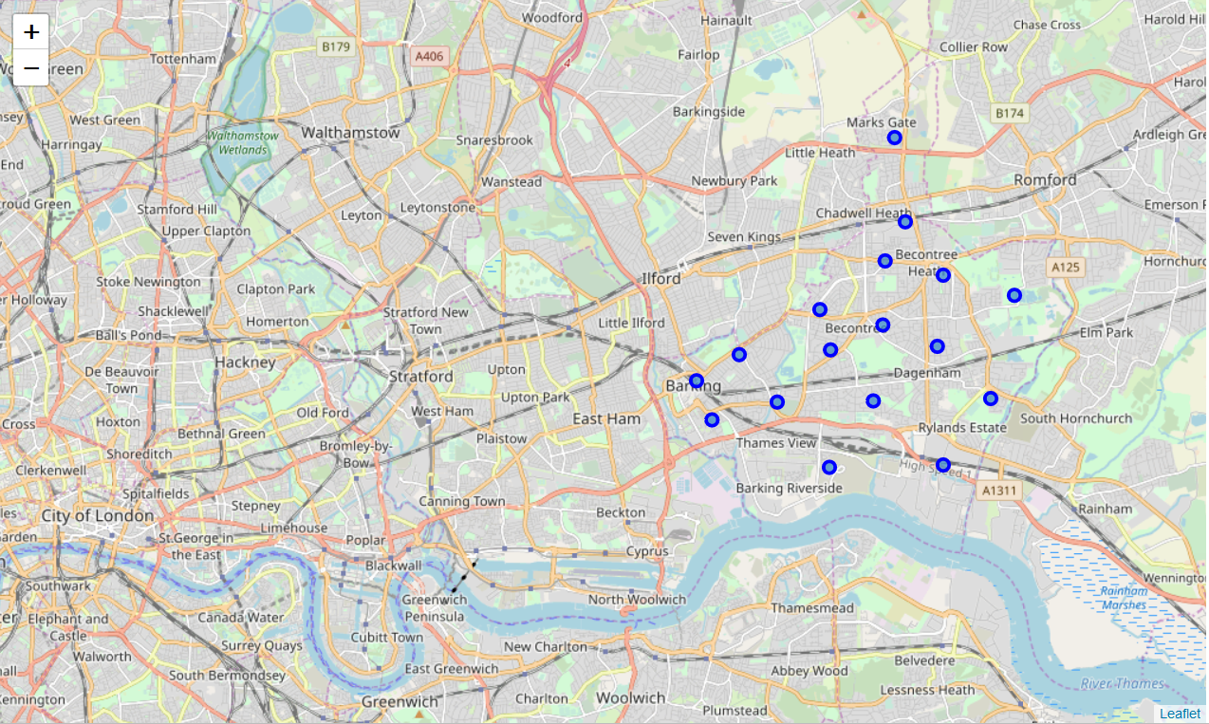
Mapping London

Slide 10
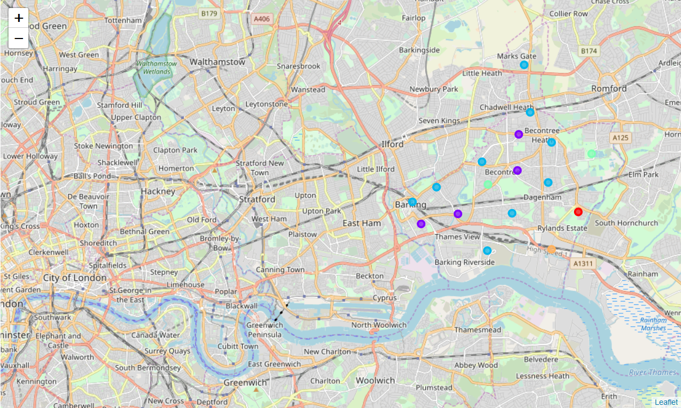
Mapping clusters

Slide 11
Results and Discussion
The most populated areas are Cities, however the conurbation is the least which was against our expectations. There is a chance that country people are moving closer to the cities but the city itself is already to crowded or expensive to them
Not the City is which have the highest population density among the observed areas. Hamlets are still the least crowded area, no surprise on this.
The conurbation area have the youth. So it can mean that the younger generation is moving there from the rural.
Most of the crimes are committed in conurbation area. The presence of the police might have more patrol in the inner city or maybe the conurbation area is just too big to supervise.
I assume that a lot of people move to conurbation recently. This can be the explanation of the high average price, also it can explain the density

Slide 12
Conclusion
Based on the data and the clusters information I would check Cluster 1 and Cluster 2. According the data and the venues information they seem work to me. They both approachable with public transport which is necessary to me. Also they have places which can make the weekdays easier.
I would check Cluster 1 at first

